Slide 1
CREDIT EDA Assignment
PRATIK PRADEEP GAWADE
UpGrad DS C63

Slide 2
Univariate Analysis
Categorical – Numerical Analysis
Numerical – Numerical Analysis
Categorical – Categorical Analysis

Slide 3
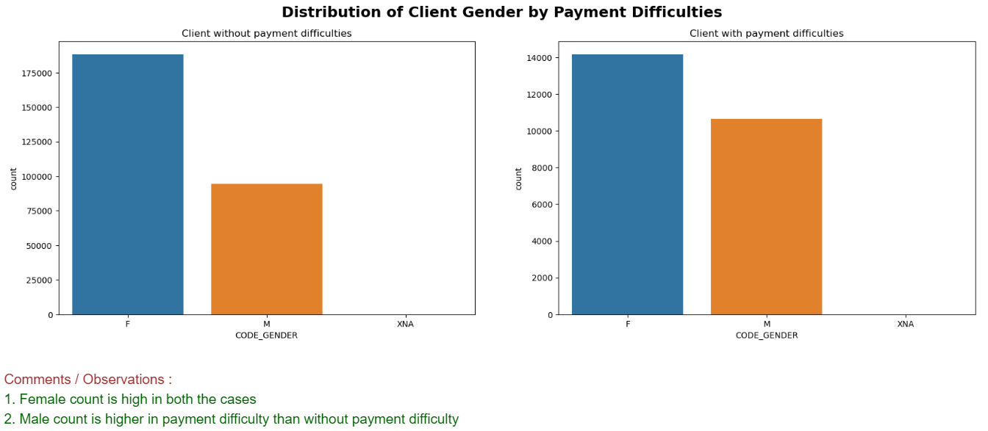

Slide 4
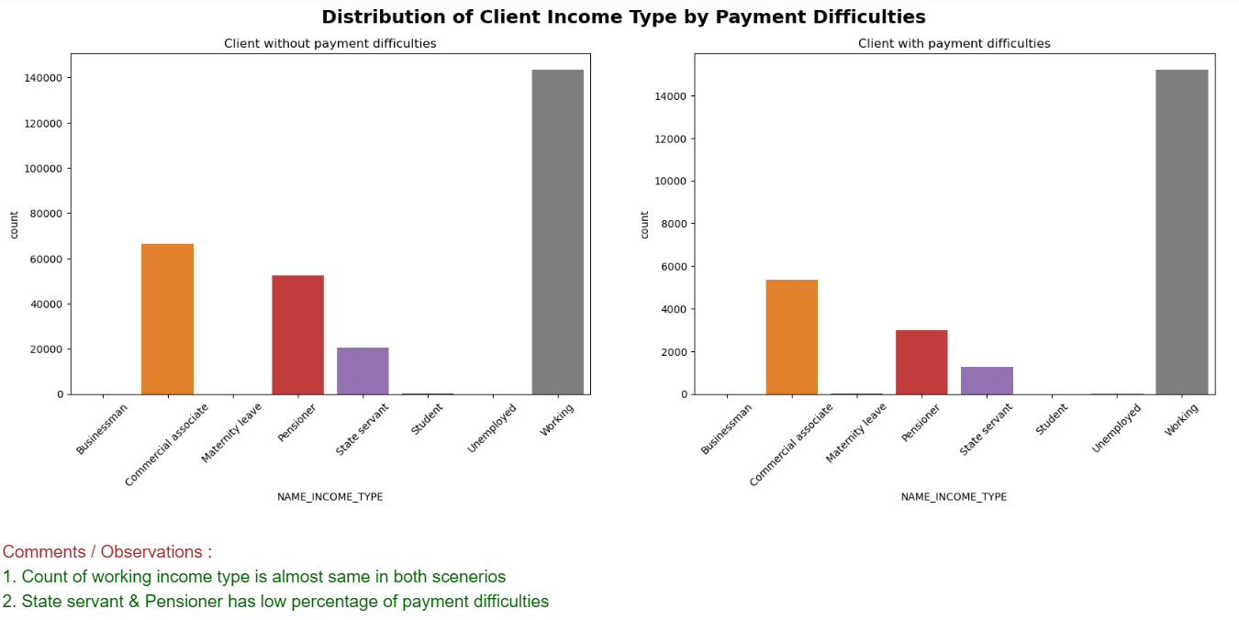

Slide 5
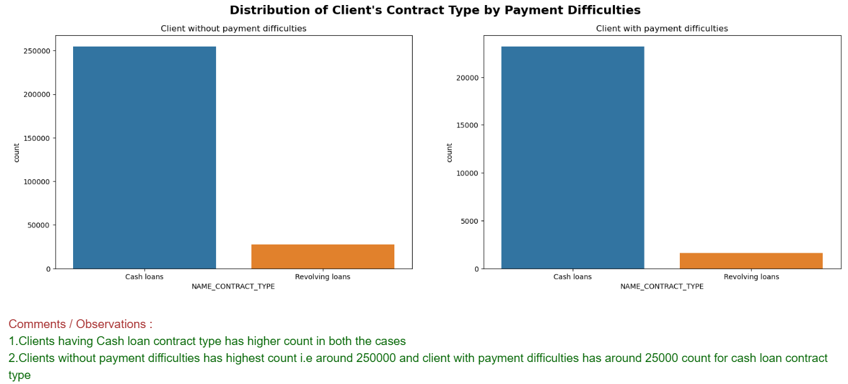

Slide 6
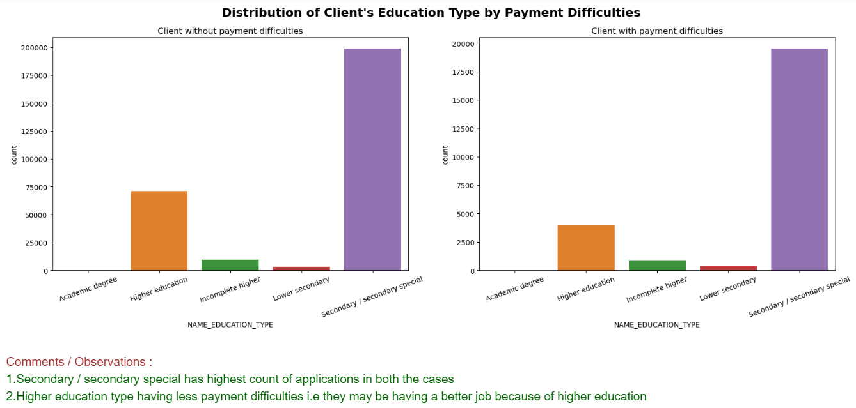

Slide 7
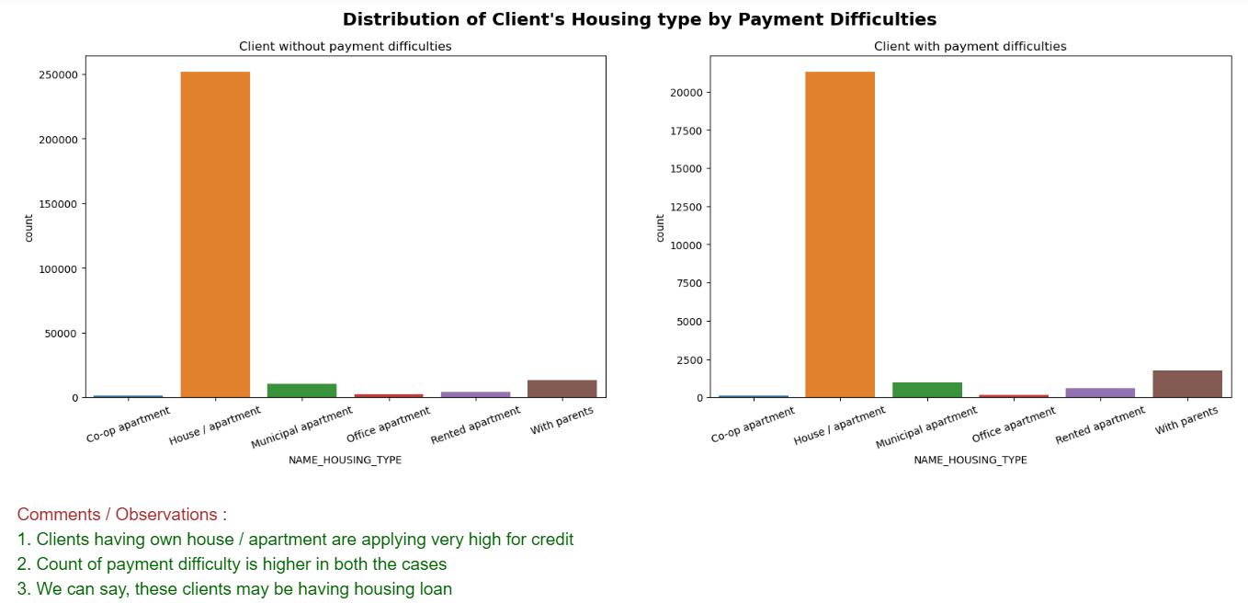

Slide 8
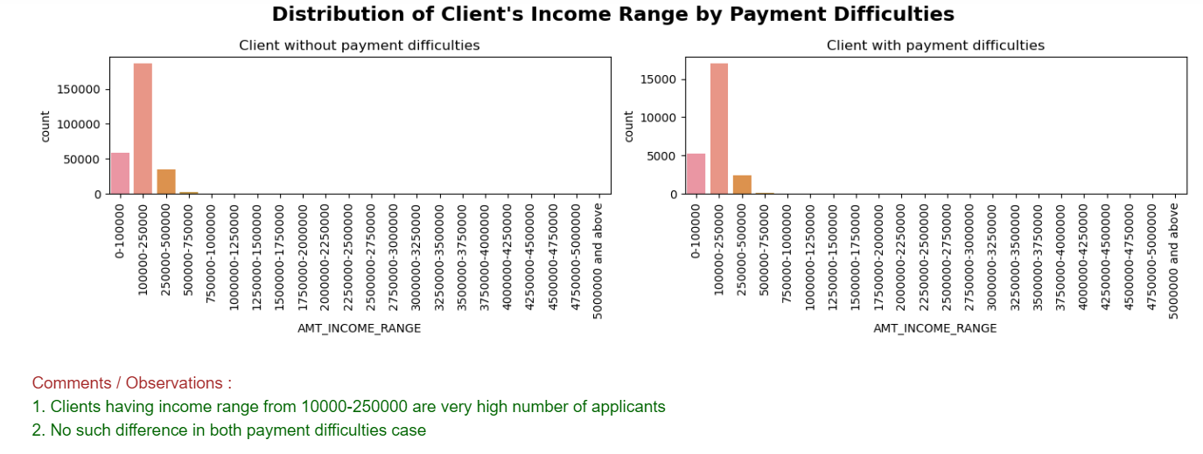

Slide 9
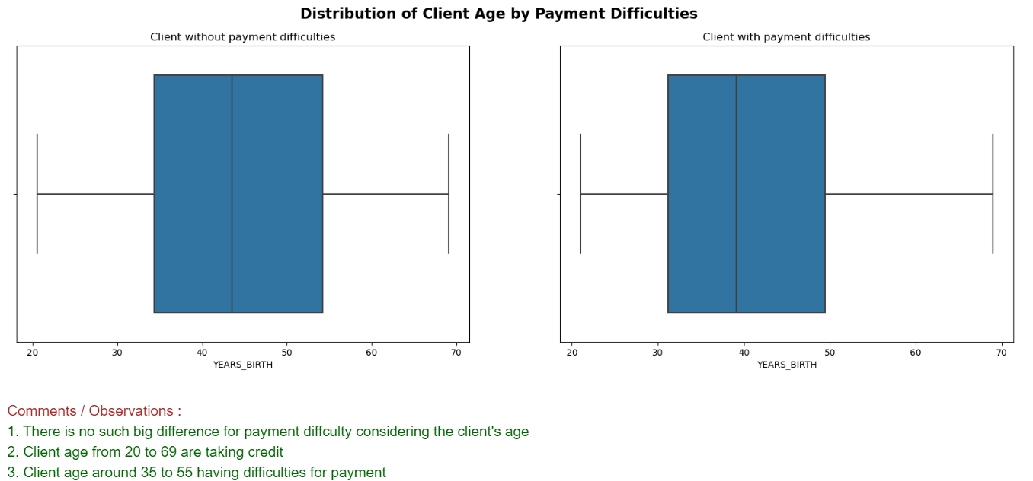

Slide 10
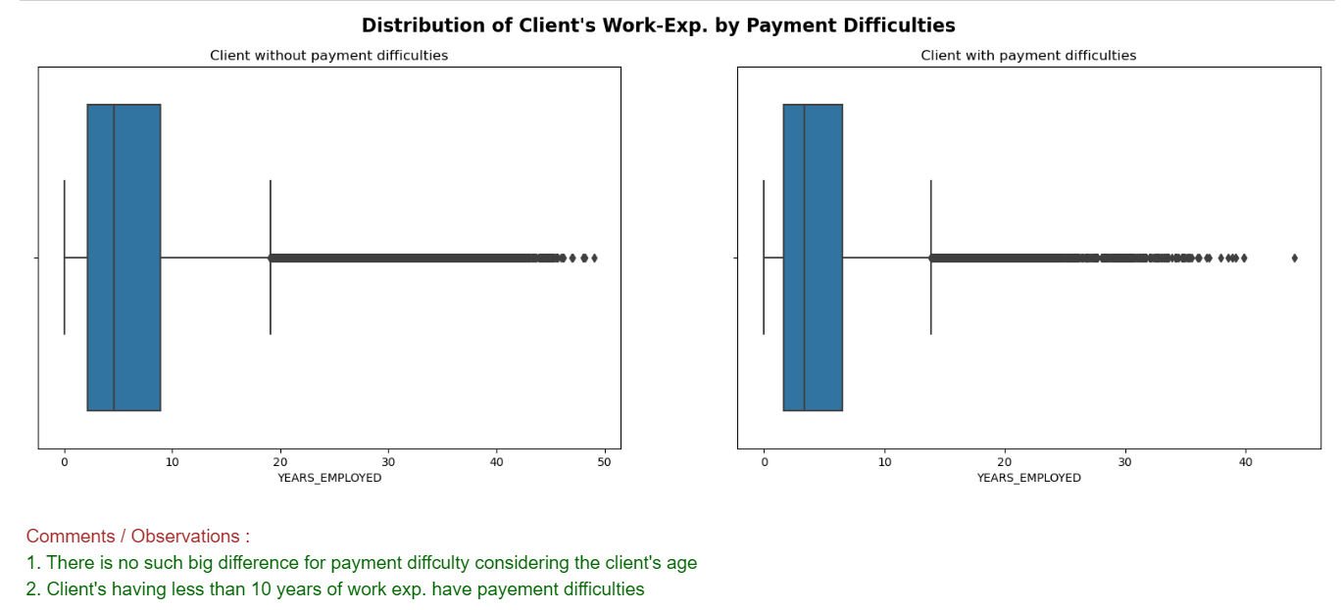

Slide 11
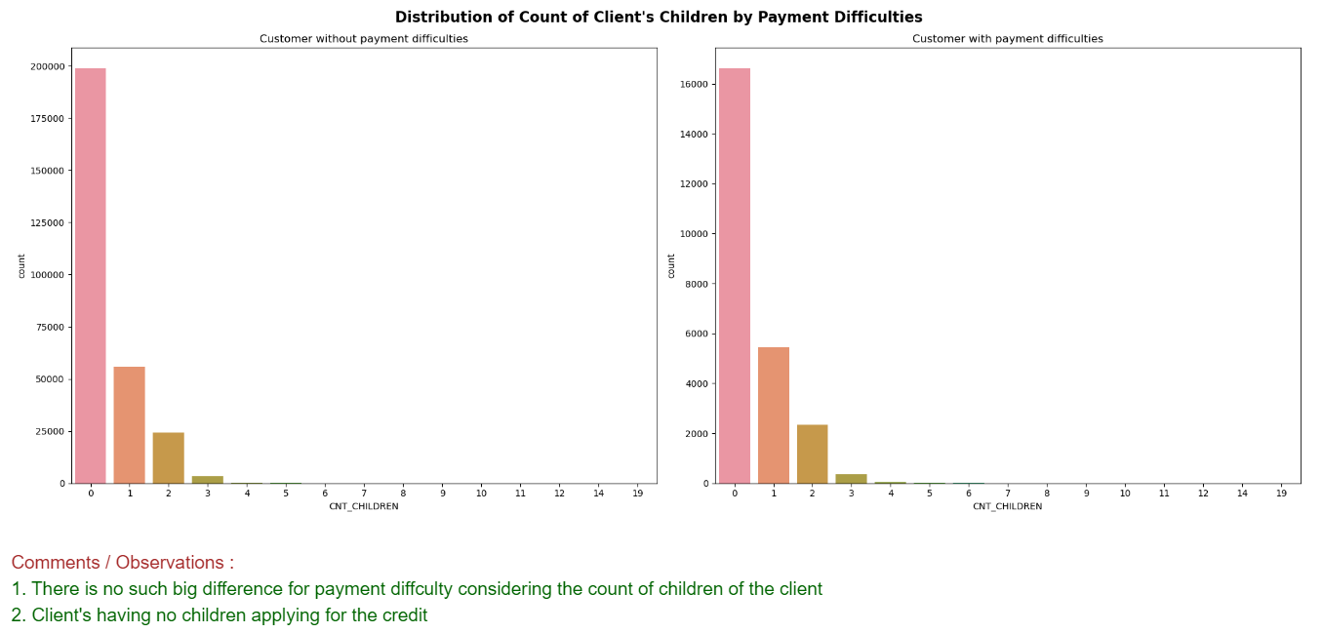

Slide 12
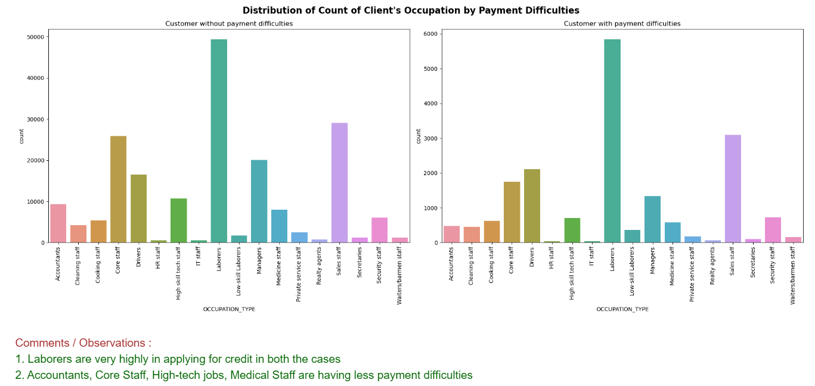

Slide 13
Bivariate & Multivariate Analysis
Numerical – Numerical Analysis
Correlation
Numerical - Categorical
Categorical – Categorical Analysis

Slide 14
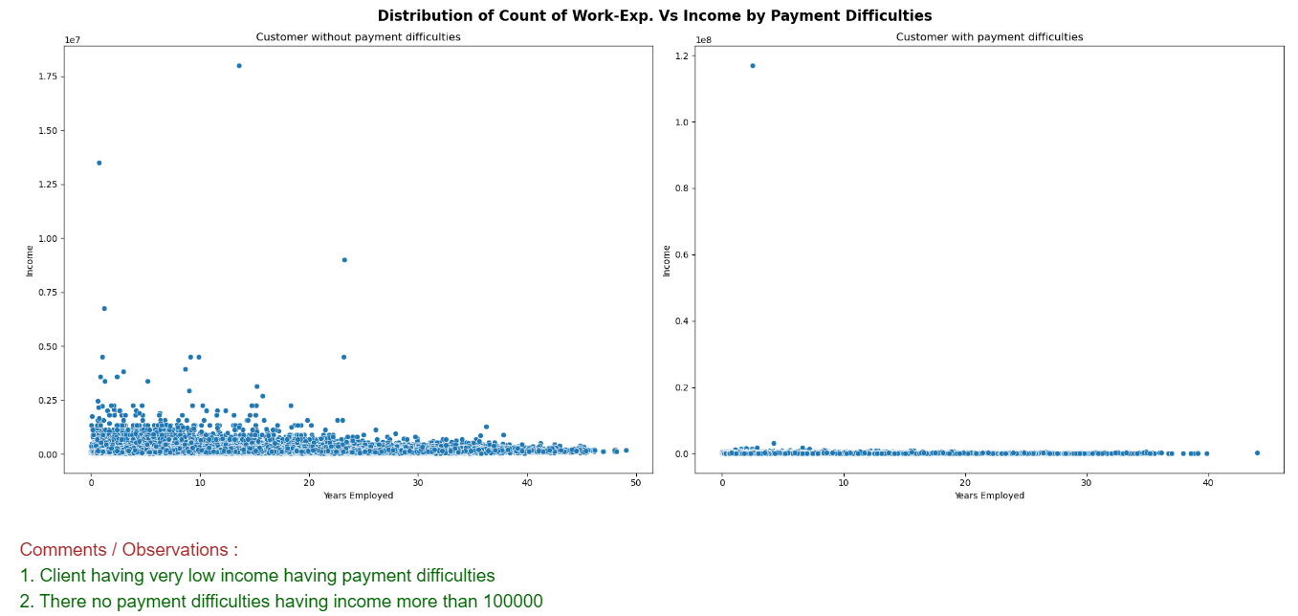

Slide 15
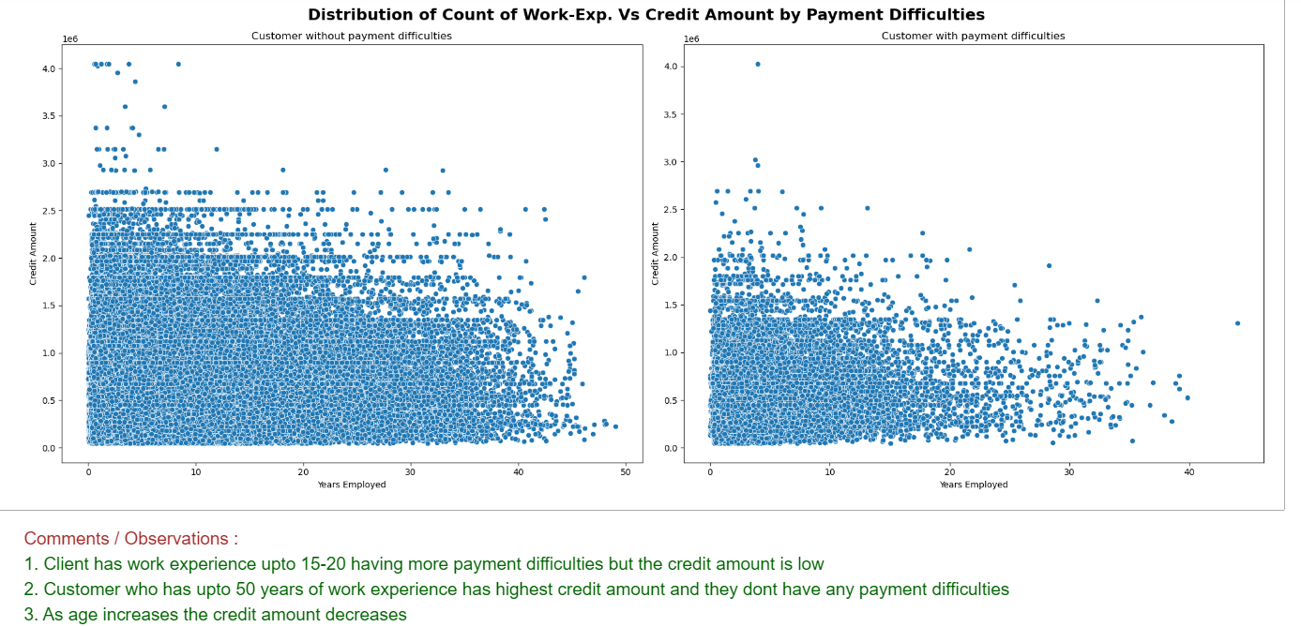

Slide 16
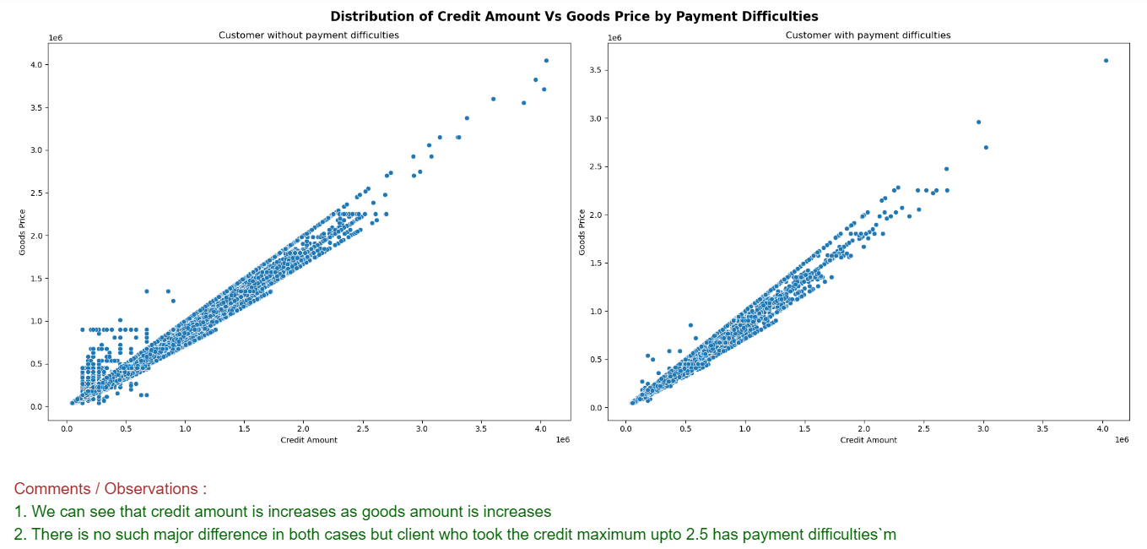

Slide 17
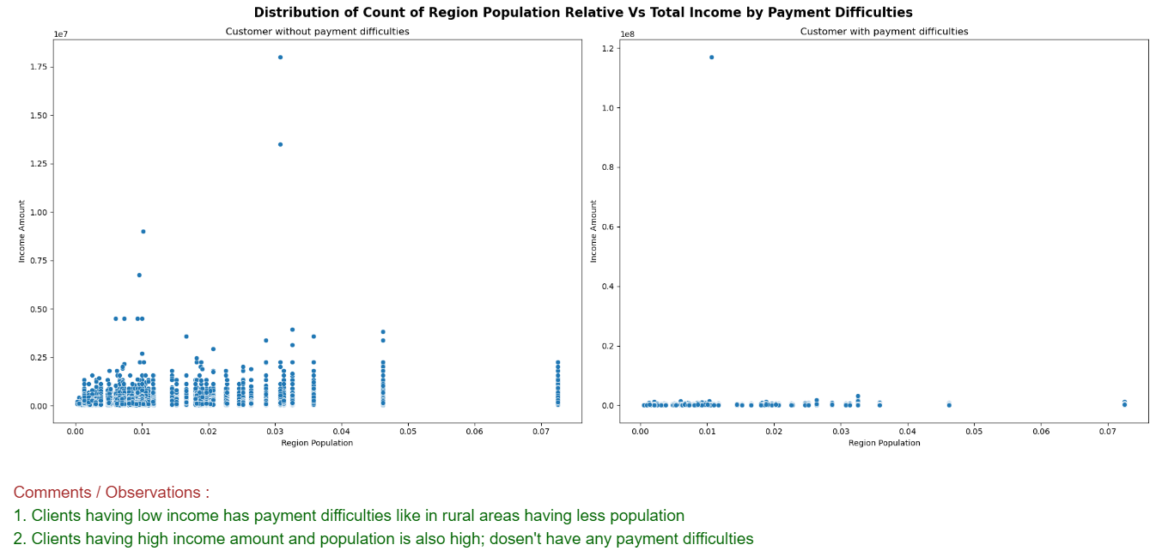

Slide 18
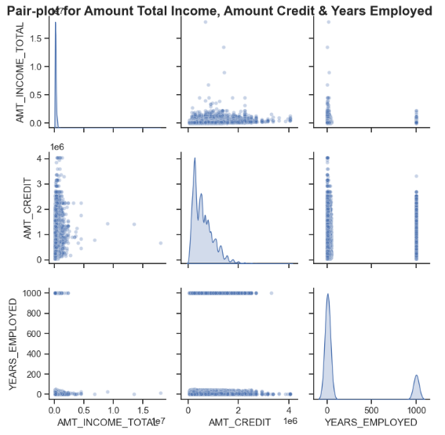

Slide 19
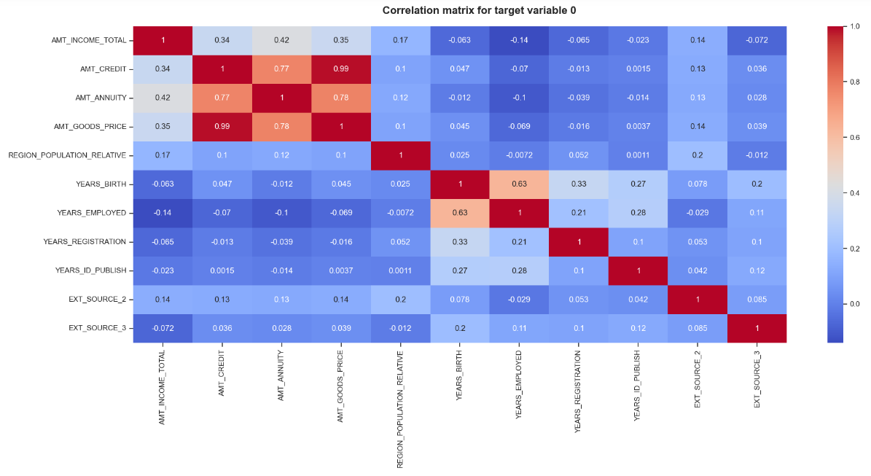

Slide 20
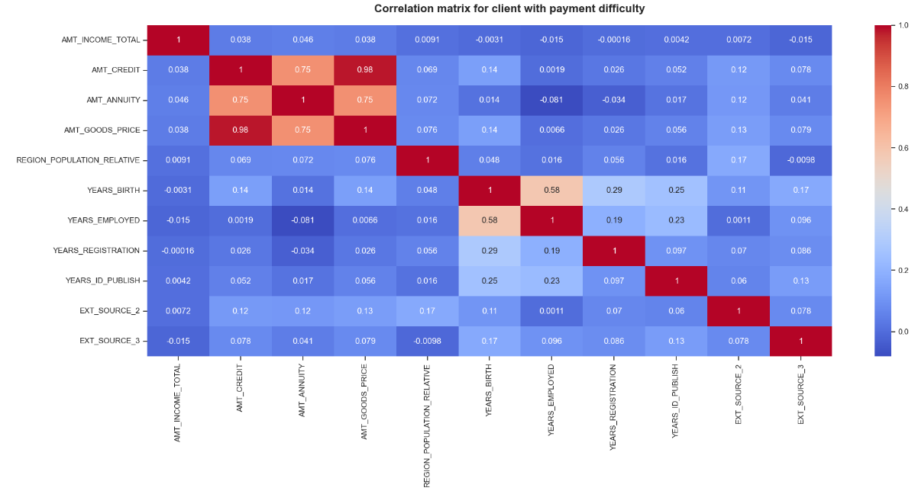

Slide 21
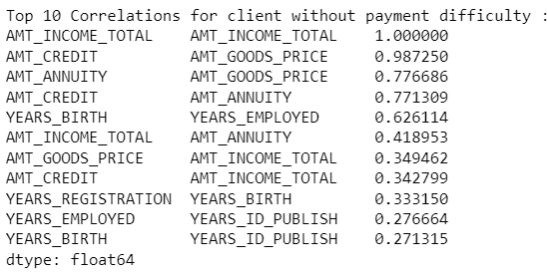
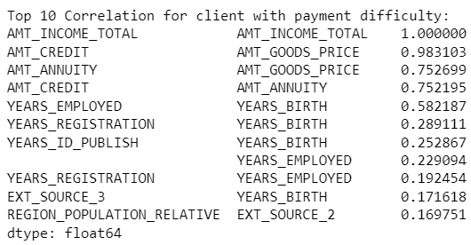

Slide 22
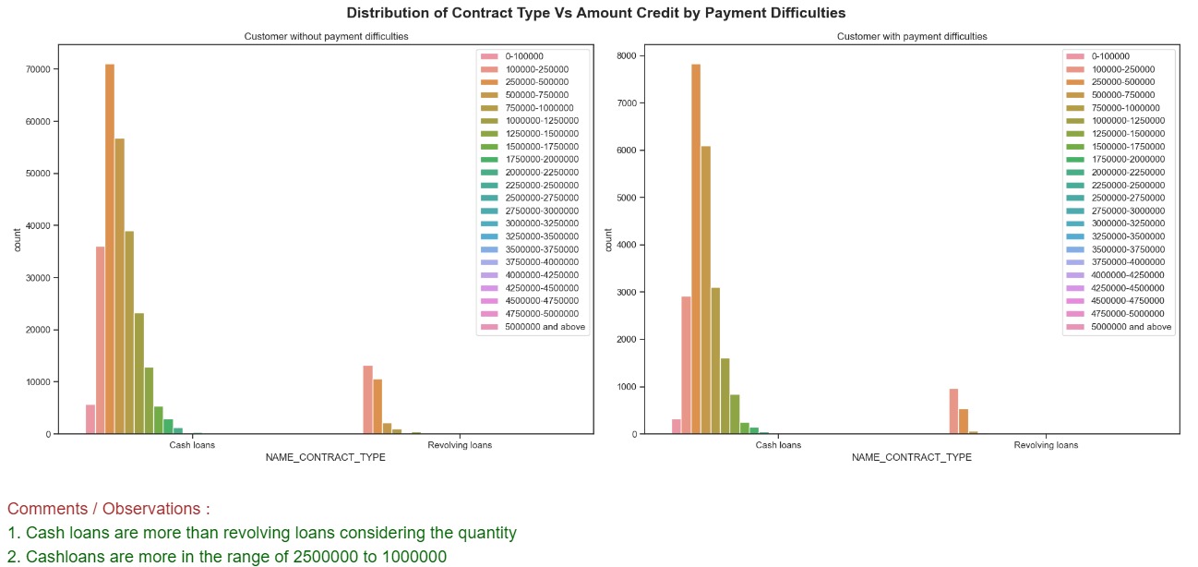

Slide 23
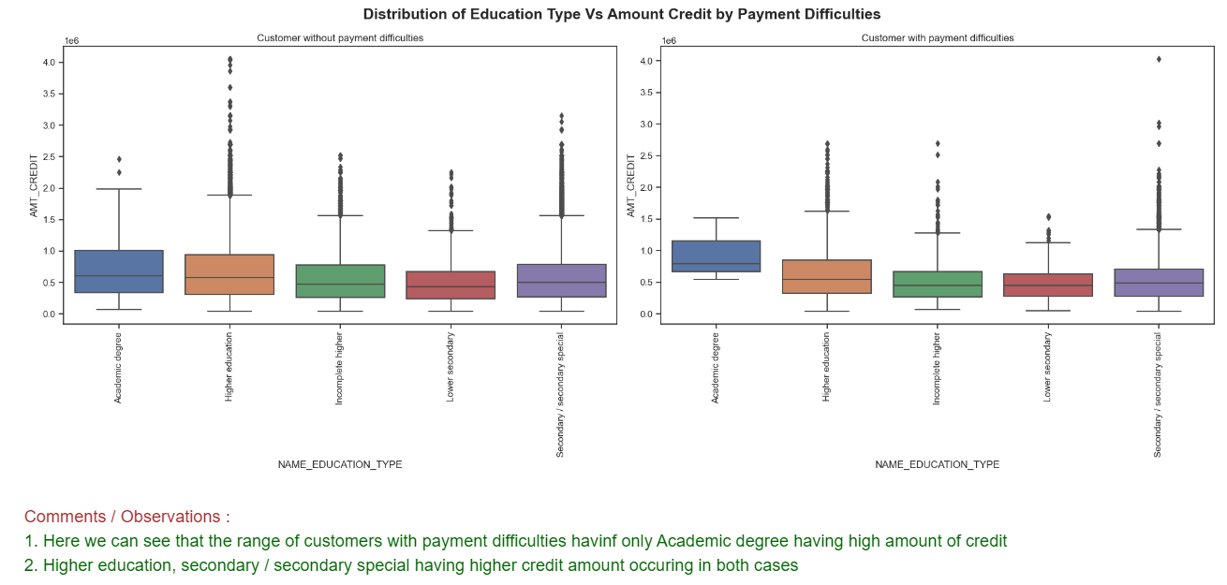

Slide 24
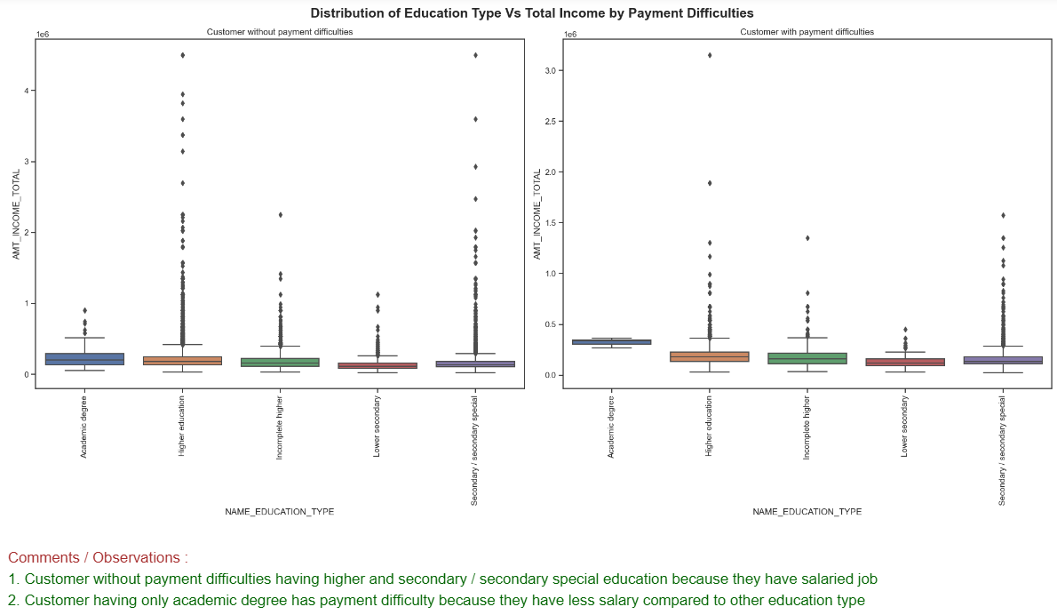

Slide 25
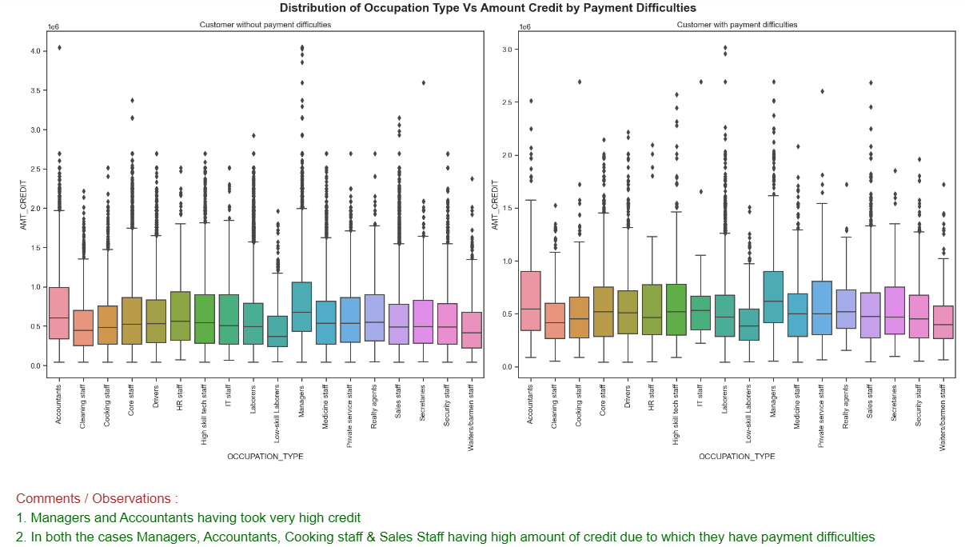

Slide 26
Merging datasets
Analysis after merging previous application data

Slide 27
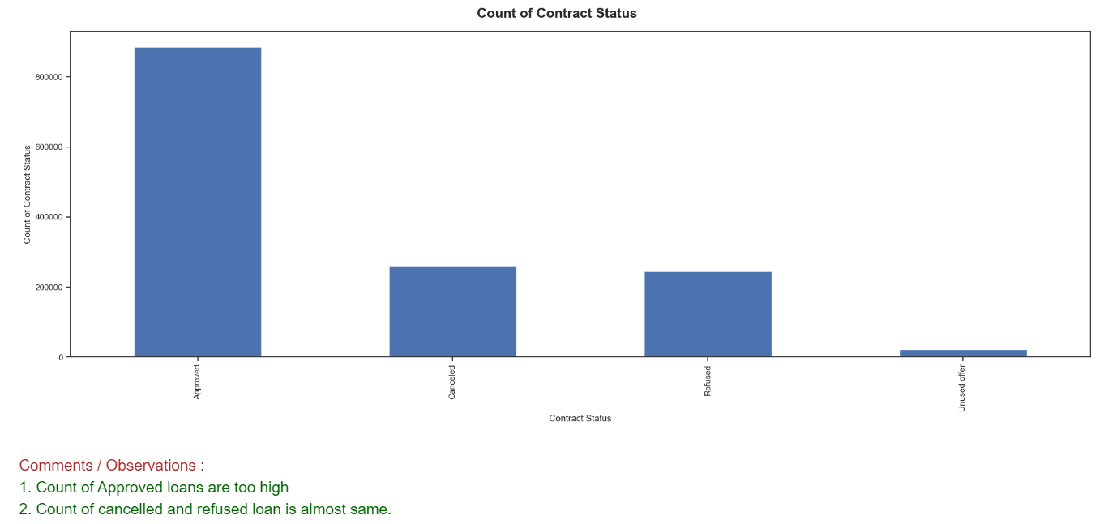

Slide 28
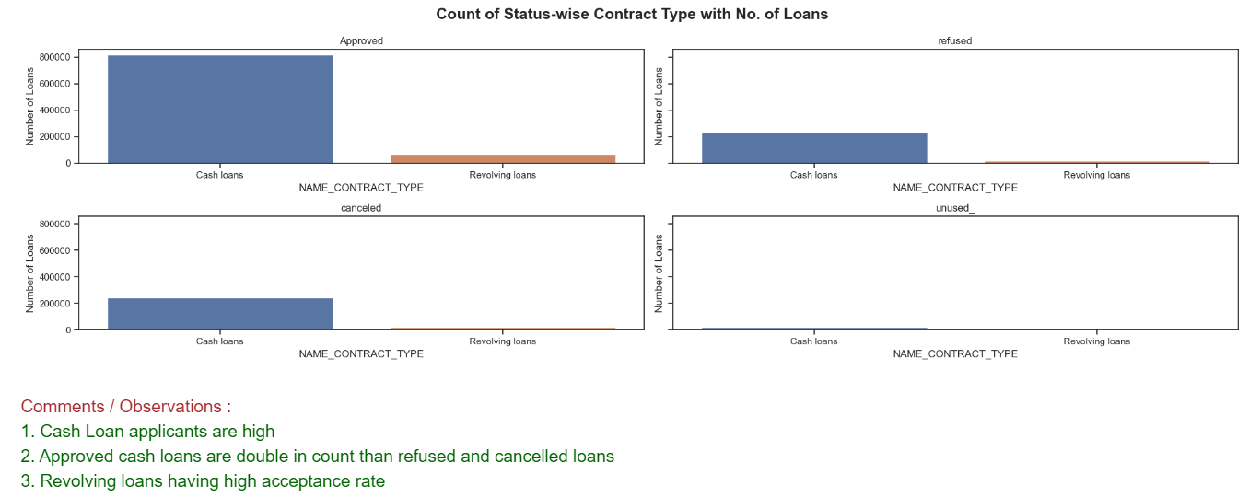

Slide 29
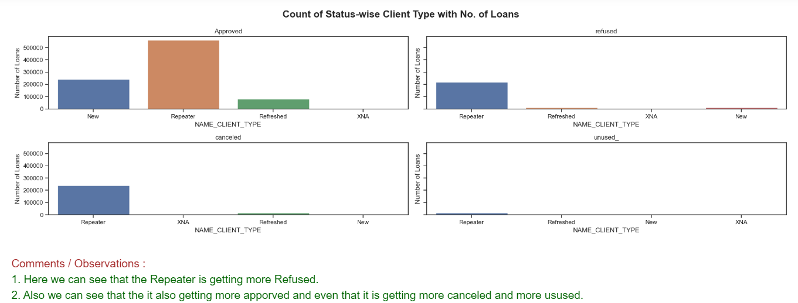

Slide 30
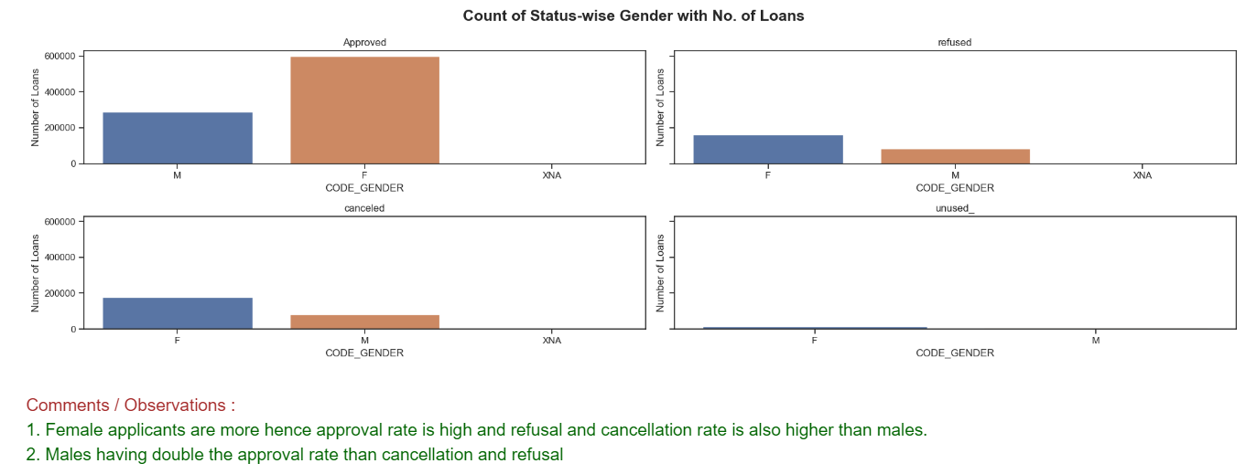

Slide 31
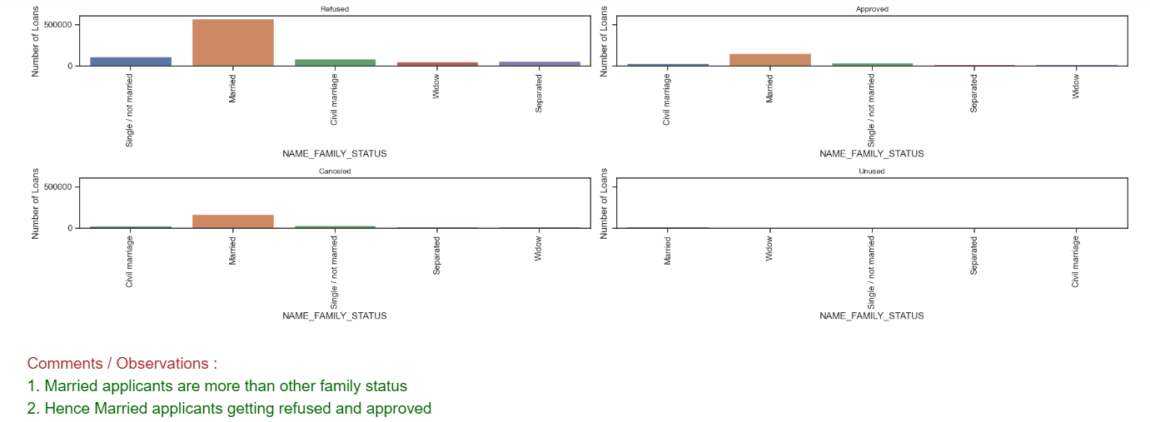

Slide 32
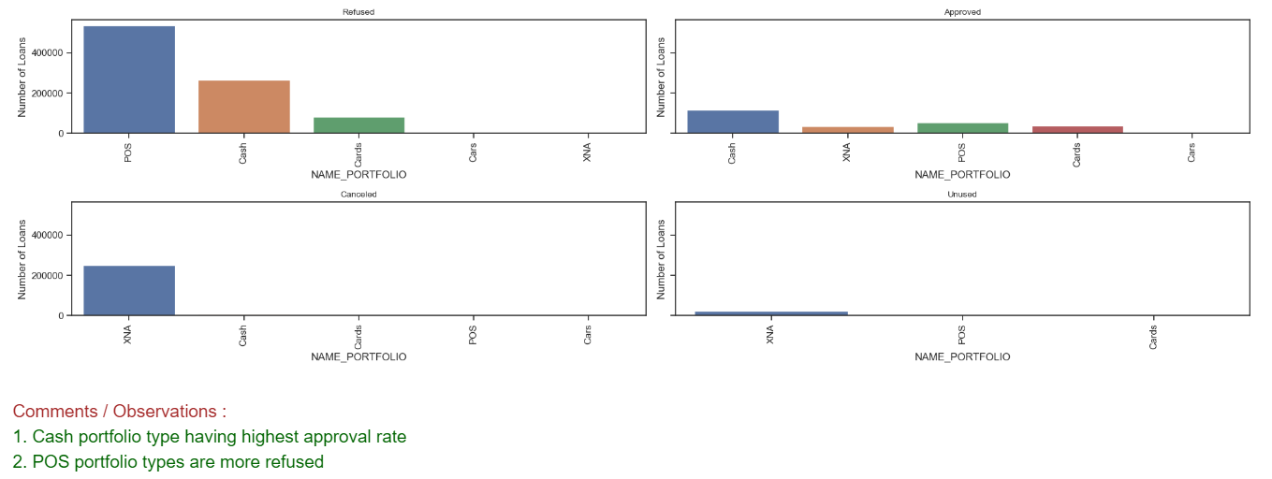

Slide 33
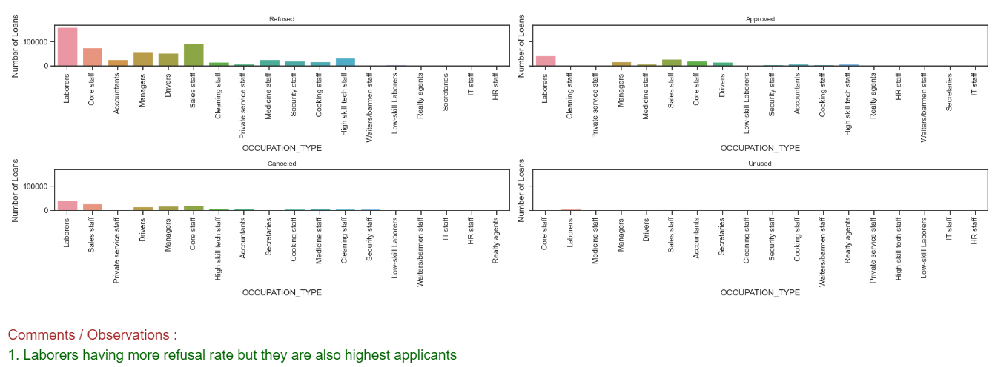

Slide 34
Conclusions:
Banks should focus less on income type ‘Working’ as they are having most number of unsuccessful payments.
Loan Purpose on 'Repair' having highest number of unsuccessful repayments.
Housing Type 'With Parents' having least number of unsuccesful repayments.
In Genders, 'Females' are more in number for applying loans.
Banks should focus on 'Students' ,'Pensioner' for successful repayments.

